Slide 1

Category Code: C1 (Open Innovation)
Problem Statement Title: EduTrade - Swap Skills, Gain Expertise
Team Name: Caffeine Coder
Institute Name: Vivekanand Education Society’s Institute of Technology

Slide 2

Idea / Approach details
Problem Statement: Many individuals struggle with limited access to quality education, skills mismatching job market demands, financial constraints, and lack of professional networks, leading to unequal job opportunities.
Solution Overview: EduTrade is an AI-powered platform that bridges the gap between learning and employment. It provides personalized skill assessments, free learning resources, AI-driven job matching, a Skill Swap Marketplace, and instant resume generation to help users secure sustainable careers.
Target Users:
Students & Fresh Graduates – Seeking skill development, mentorship, and job opportunities.
Job Seekers & Career Changers – Looking for AI-driven job matching and skill enhancement.
Mentors & Industry Experts – Offering guidance, validating skills, and conducting learning sessions.
Employers & Recruiters – Posting jobs, reviewing candidates, and hiring skilled professionals.

Slide 3
Implemented Features
Live Face Monitoring: Tracks emotions and stress levels in real-time.
Employer Job Listings & Posting: Employers can post job openings and manage listings.
Role-Based Sign-In: Secure authentication with different access levels for employers and job seekers.
AI Resume Parser & Scorer: Automatically extracts key details from resumes and provides a score.
Skill Matching & Swapping: Enables users to exchange skills dynamically for better job opportunities.
Mentoring Sessions: Connects users with industry experts for guidance and career growth.

Slide 4
Innovation (Showstopper)
Skill Swap Marketplace
  Users exchange skills (e.g., coding for UI/UX) using a time-based token system.
  AI or manual matching ensures fair and relevant learning exchanges.
Job Market Integration
  AI-driven smart job matching connects users with relevant opportunities.
  Includes resume building, interview prep, and direct recruitment.
Automated Resume Analysis
  Extracts key details (skills, experience, education) and evaluates resumes based on job relevance using AI.
AI-Powered Scoring & Feedback
  Assigns a score to resumes and provides real-time suggestions for improvement to enhance job matching.

Slide 5
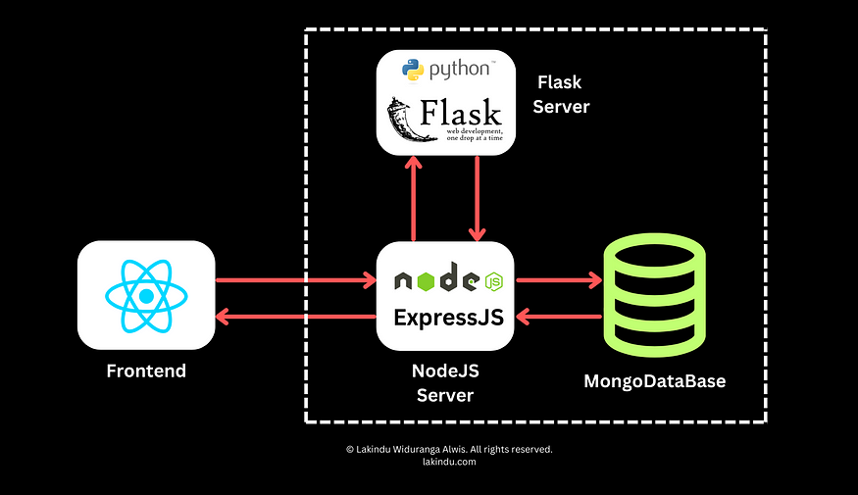
Tech Stack
Frontend: React.js
Backend: Node.js, Flask
Database: MongoDB
Machine Learning: Python

Slide 6
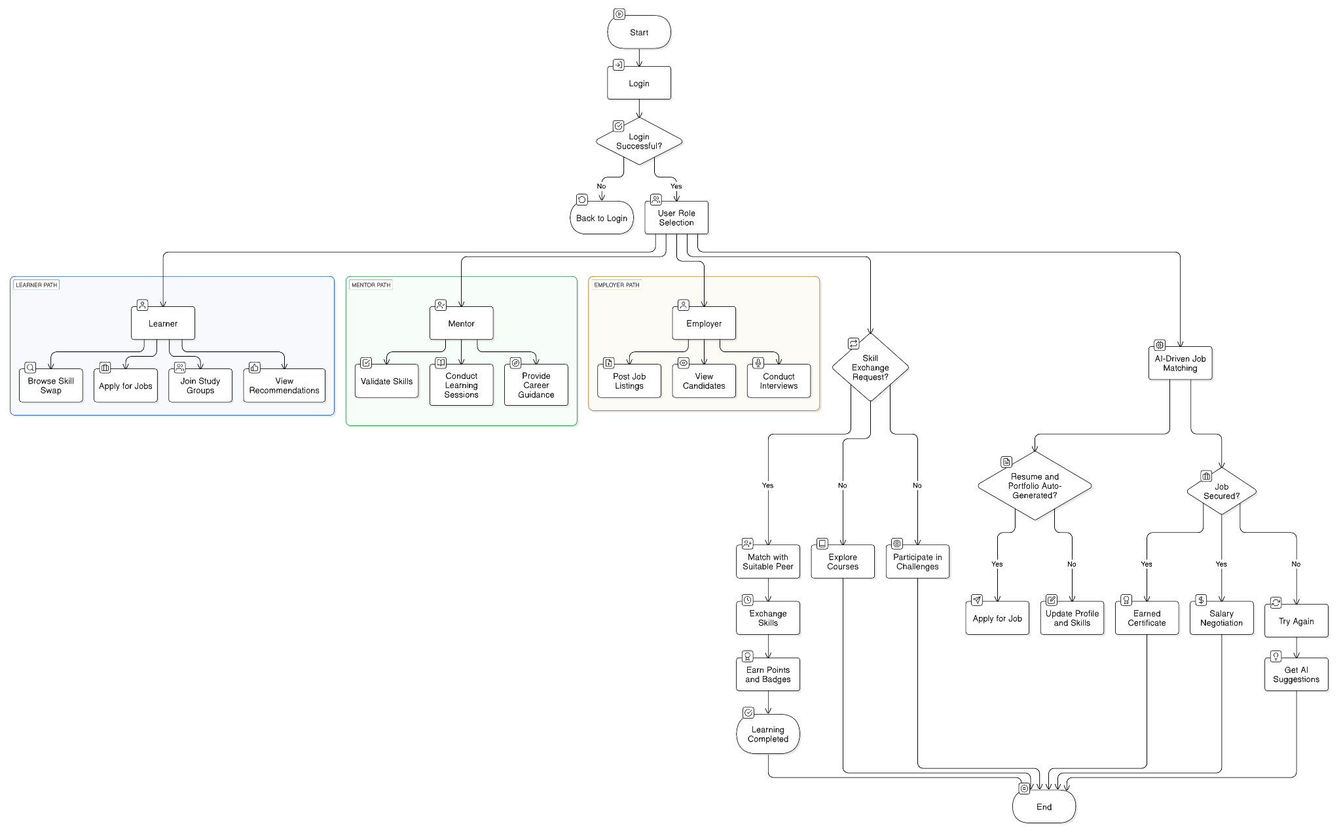
Use Case Diagram

Slide 7
Future Objective
Peer-to-Peer Learning via Video Calls – Enables live skill exchange sessions through secure video calls, fostering interactive learning and mentorship.
Decentralized Learning & Skill Verification – Blockchain-based certificates for verified skill endorsements and decentralized skill records to ensure credibility across platforms.
AI Video Summarizer for Skill Swap Sessions – AI-powered summarization of recorded sessions for quick knowledge retrieval and learning insights.
Metaverse & VR-Based Learning Modules – Immersive learning through VR-based training simulations and virtual skill swap rooms for hands-on experiences.
Smart Contracts for Skill Exchange & Payments – Secure and automated transactions using blockchain to ensure fair exchanges and fraud prevention in freelancing & mentorship.
Automated AI Job & Internship Applications – AI auto-applies to relevant jobs and internships based on user skills, with smart tracking of application status and interview scheduling.

